Slide 1
Lite-On Singapore (LOS)
11KW OBC Microprocessor Partitioning
02/02/2023

Slide 2
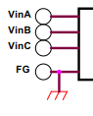
11KW OBC - MCU Architecture
PFC_OUT
800V DC Output
AC INLET
RELAY
Input Voltage, Current Sensing
PFC Output Voltage Sensing
Output Voltage
Current Sensing
EMI
NPC
Rectifier
DC Link
Bulk Cap
CLLLC DC-DC Converter
HV DC TERMINAL
BATTERY
PFC
NEG
Relay
Drive
PWM Driver
V_OUT
I_OUT
PWM
Driver
TI
TMS320F28379S
PWM Driver
SR PWM
PWM
Outputs
Analog IN
Output Voltage
Sensing
Relay PWM
PWM
Isolator
I_CLLLC
HW OCP
TI
TMS320F28379S
VPFC
Analog IN
PWM
Outputs
VPFC_OUT
TZ
Analog IN
Phase A, B, C
Analog IN
CLLLC PWM
PWM
Outputs
HW OVP
ORPS PWM
CAN
Zero Crossing Detector Digital Input - 3
TZ
Secondary Auxiliary
Supply (Open Loop)
DI
APM
Primary
DI
PWM Outputs
BS_PWM
Auxiliary Supply –(to Pri. Drive Circuits)
Control PWM (Open Loop)
ZCD A, B, C
(ECAP)
PFC_OK , AC_OK
Additional Analog Sensing
VBIAS – 1 Ch
NTC Thermistor – 1 Ch
(3 ADC temp sense Channels are connected through an Analog Mux).
DI
PFC_EN
ISO7241CDW
Isolator
Analog IN
PFC_OK , AC_OK
Mux Sel. 1-3
DO
ISO7241CDW
NXP
FS32K144
DO
CAN
CAN H/L
PSFB Controller
APM
Secondary
Isolator
SPI
CAN
PWM Output
18V_P
AUX
Power
SPI
CAN
SIGNAL CONNECTOR
Analog Input
…
Digital Input
18V_P
SBC
CAN
transceiver
Digital Output
CAN H/ L
COM (I2C/UART/SPI/CAN)
3.3V _P
TZ Input

Slide 3
11KW OBC - CAN Communication
OBC
For OBC Control and Data
CAN Transceiver
CAN Transceiver
CAN Transceiver
Primary DSP / TI
Secondary DSP / TI
CAN Stack
CAN Stack
APM / NXP
GUI/ECU
AC_OK
OBC_OK
CAN Stack
PFC_OK
DSP_OK
CLLLC_OK
UARTStack
PFC EN
UARTStack
CP_READY
UARTStack
UARTStack
CAN ECU
Reserved for Future
CAN Stack
Reserved for Future
CAN Transceiver

Slide 4
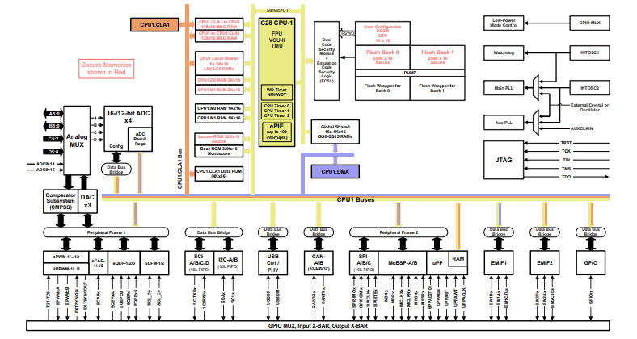
TI TMS320F28379S
TMS320F28379 32-bit CPU
200MHz
512KB flash
132KB local RAM
IEEE 754 single-precision floating-point instructions
Programmable Control Law Accelerator (CLA)
200MHz
IEEE 754 single-precision floating-point instructions
Executes code independently of main CPU
On-chip memory
512KB of flash (ECC-protected) across two independent banks
132KB of RAM (ECC-protected or parity-protected)
Dual-zone security supporting third-party development
Unique Identification (UID) number
ADC
Three 3.5-MSPS, 12-bit Analog-to-Digital Converters (ADCs)
Up to 24 external channels

Slide 5
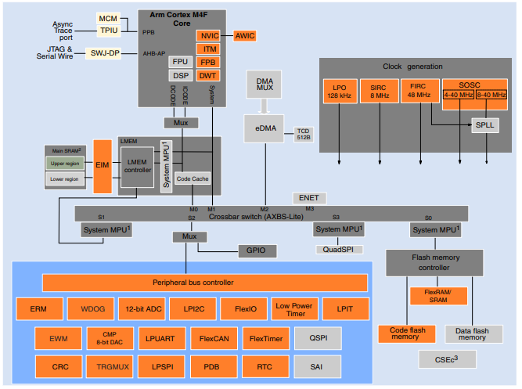
NXP FS32K144
Arm™ Cortex-M4F/M0+ core, 32-bit CPU
Supports up to 112 MHz frequency (HSRUN mode) with 1.25 Dhrystone MIPS per MHz
Arm Core based on the Armv7 Architecture and Thumb®-2 ISA
Integrated Digital Signal Processor (DSP)
Single Precision Floating Point Unit (FPU)
Memory and memory interfaces
Up to 2 MB program flash memory with ECC
Up to 256 KB SRAM with ECC
Communications interfaces
Up to three FlexCAN modules (with optional CAN-FD support)
Safety and Security
128-bit Unique Identification (ID) number
Error-Correcting Code (ECC) on flash and SRAM memories

Slide 6

Manual code
MATLAB code
Manual code

Slide 7
THANK YOU
Empowering A Green Future

